Slide 1
QGIS Useage

Slide 2
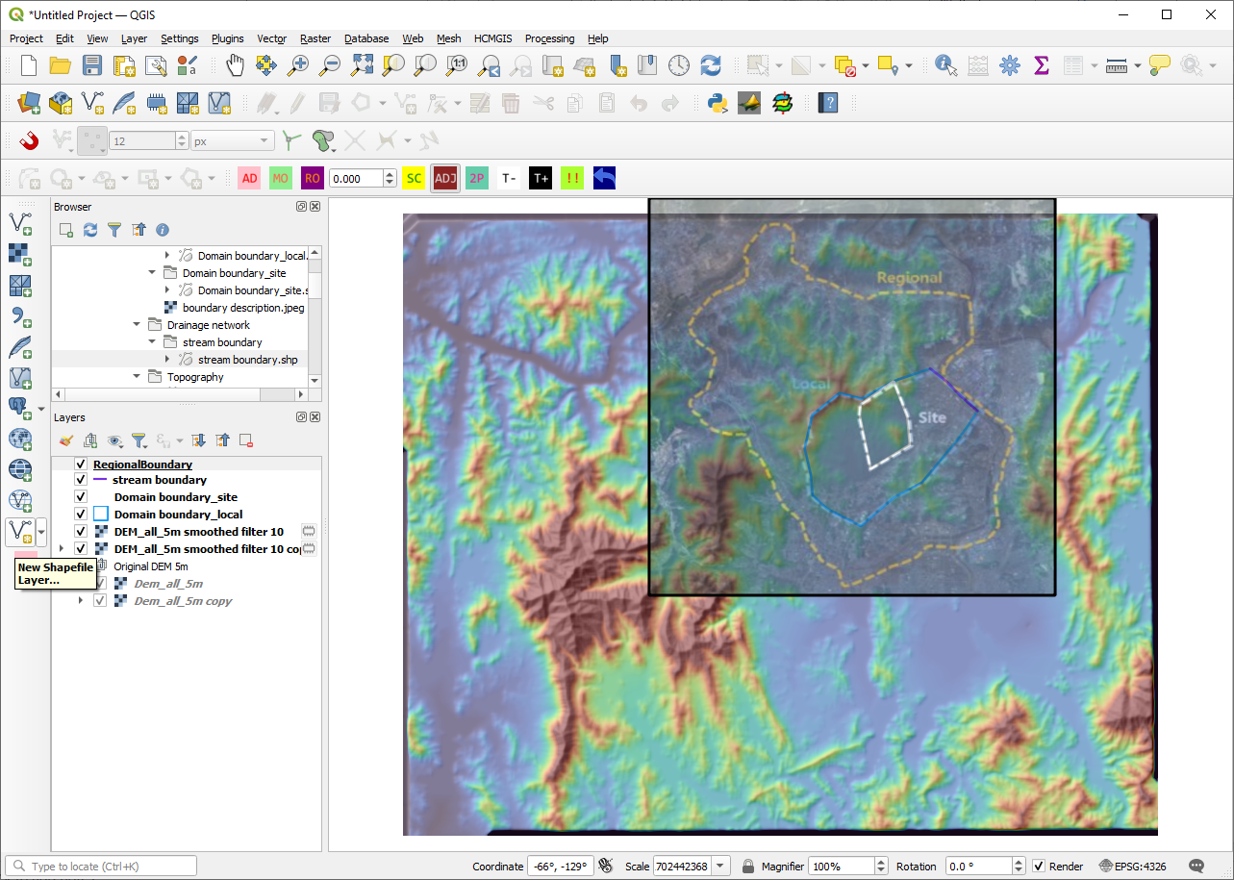
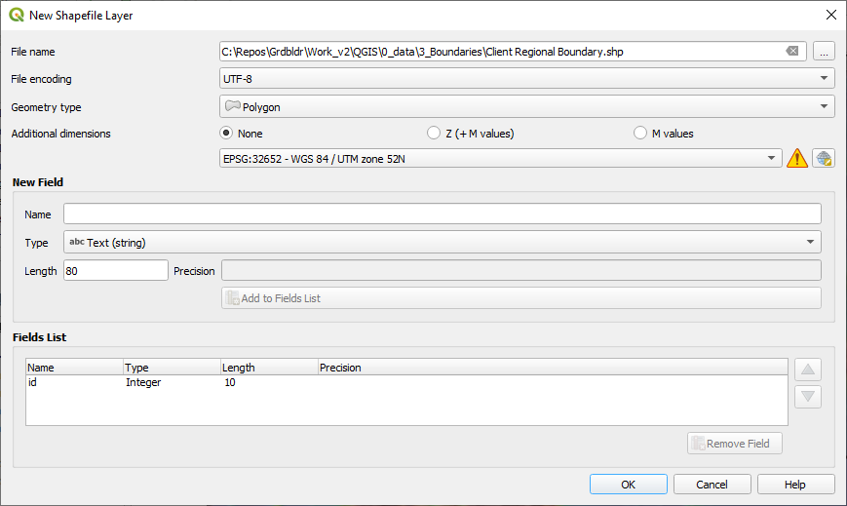
QGIS_AddNewShapefile.png

Slide 3
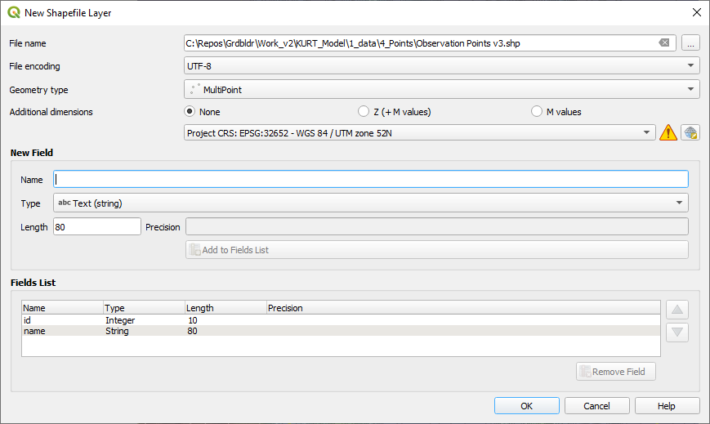
QGIS_AddNewShapefile_points.png

Slide 4
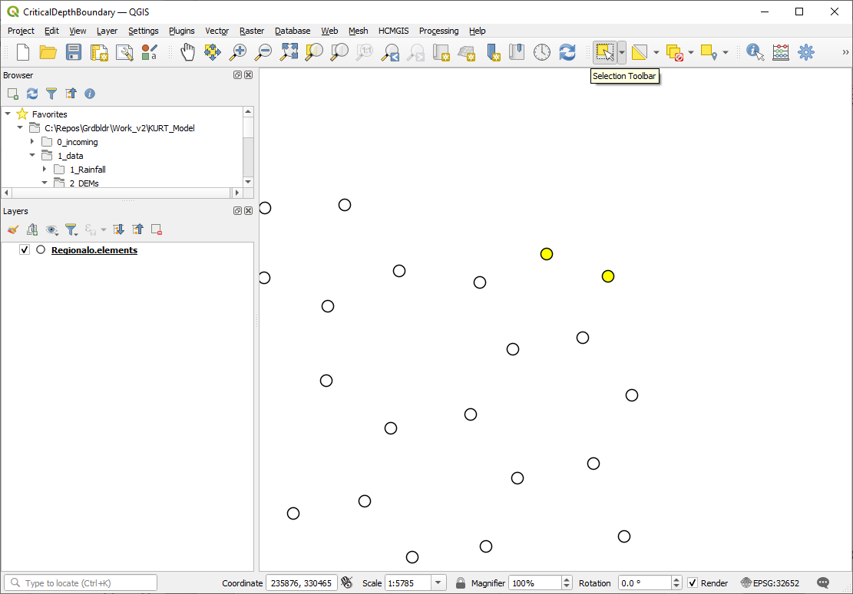
QGIS_SelectFeatures.png

Slide 5
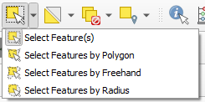
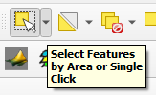

QGIS_SelectFeaturesButton.png

Slide 6
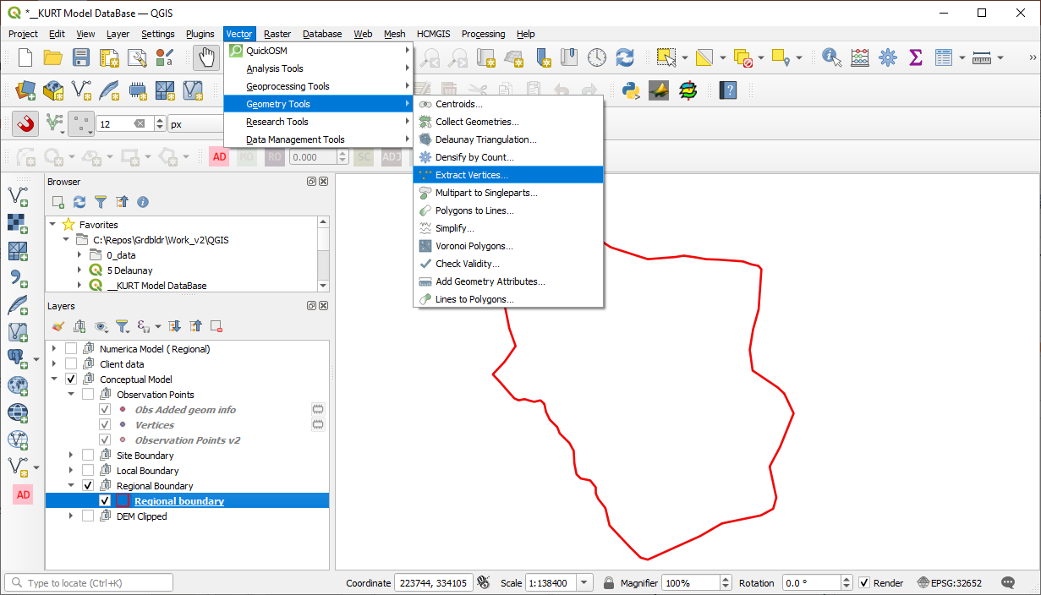
QGIS_ExportVertices_1.png

Slide 7
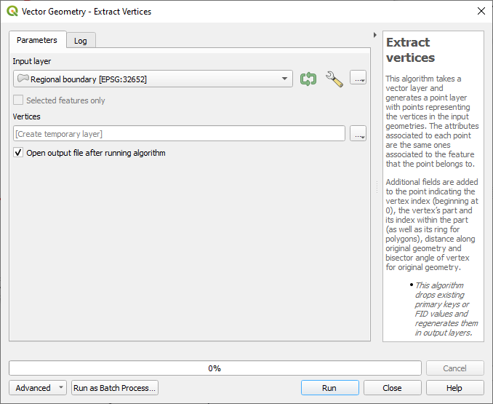
QGIS_ExportVertices_2.png

Slide 8
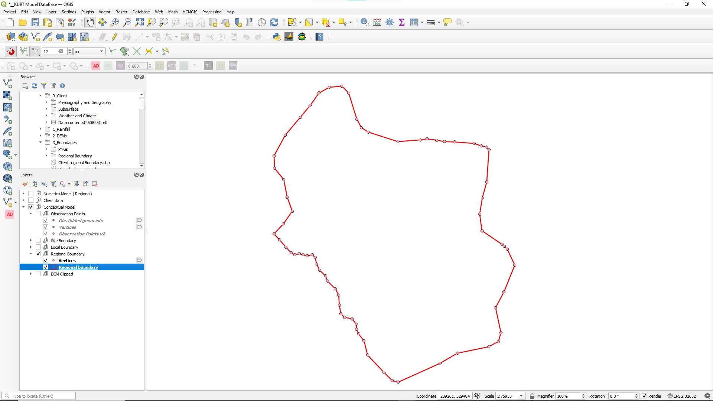
QGIS_ExportVertices_3.png

Slide 9
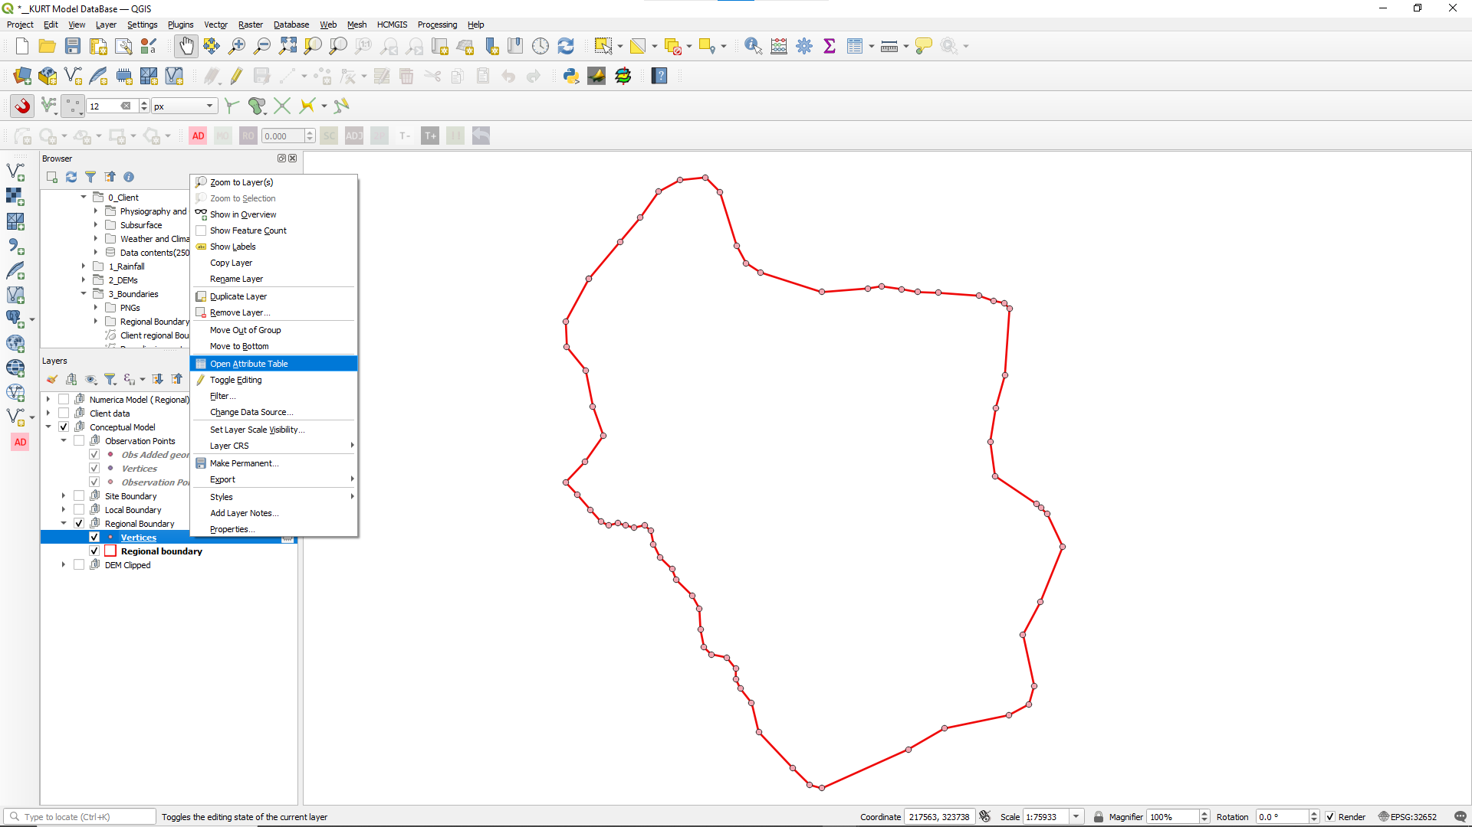
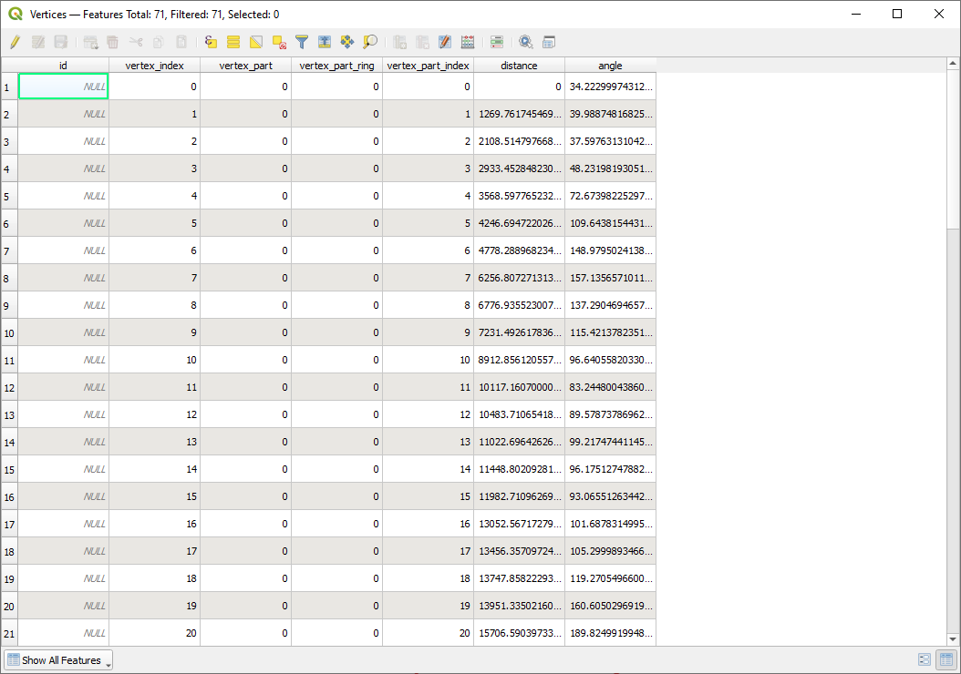
QGIS_ExportVertices_4.png

Slide 10
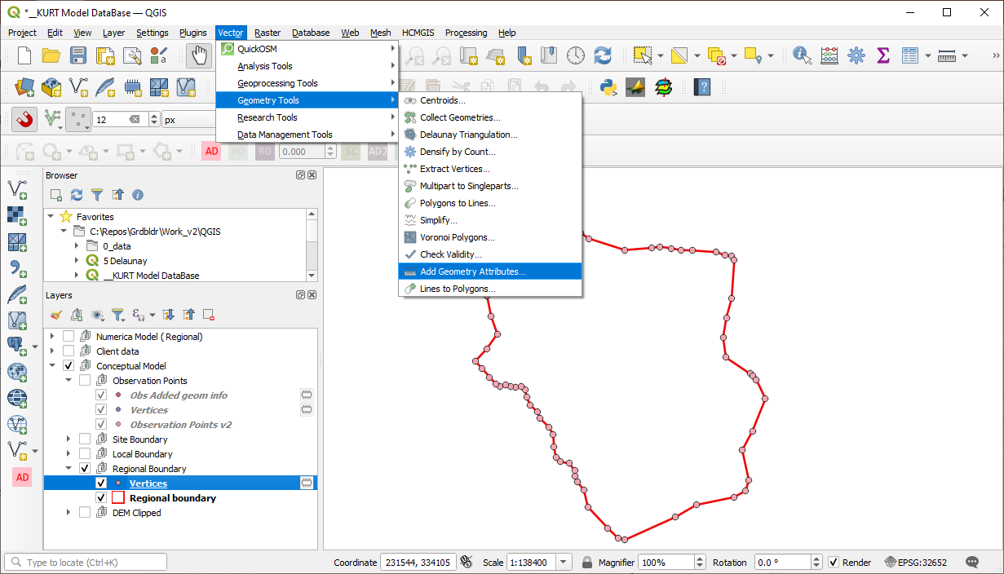
QGIS_AddGeometryAttributes_1.png

Slide 11
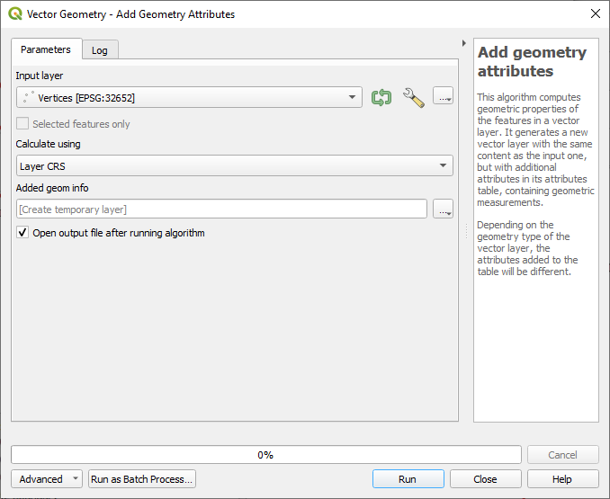
QGIS_AddGeometryAttributes_2.png

Slide 12
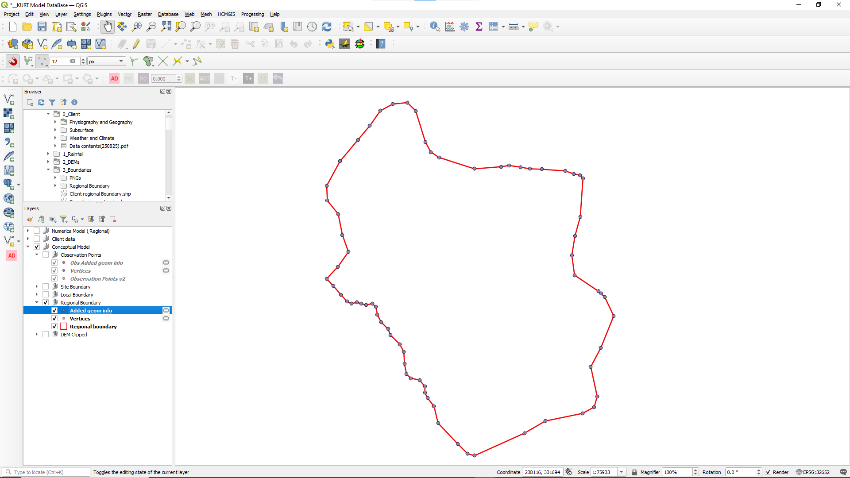
QGIS_AddGeometryAttributes_3.png

Slide 13
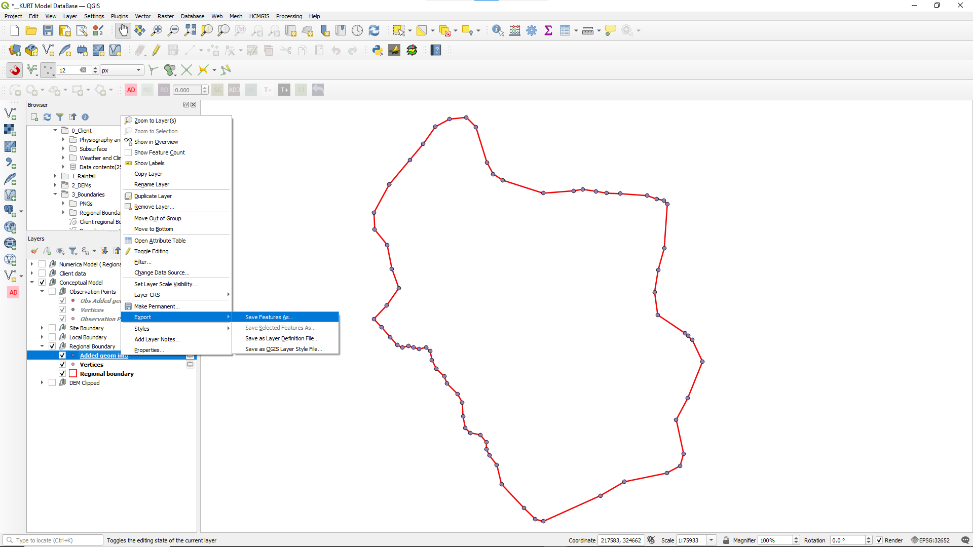
QGIS_ExportToCSVFile_1.png

Slide 14
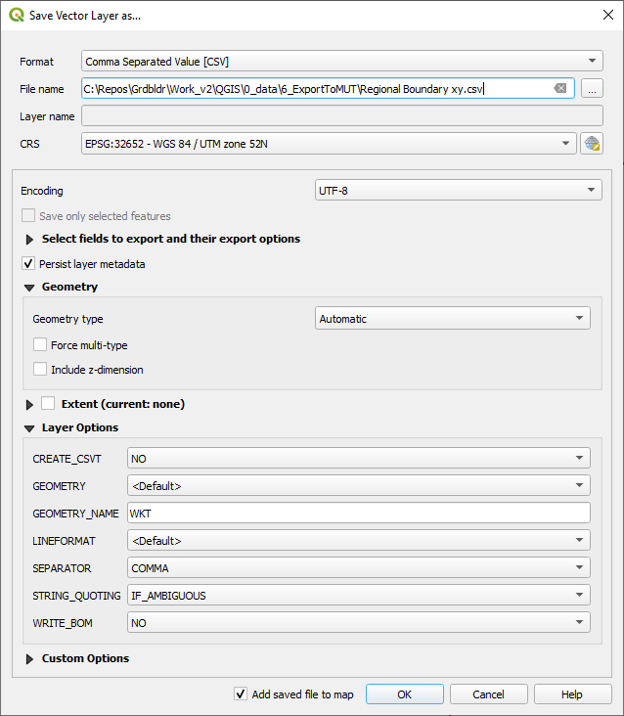
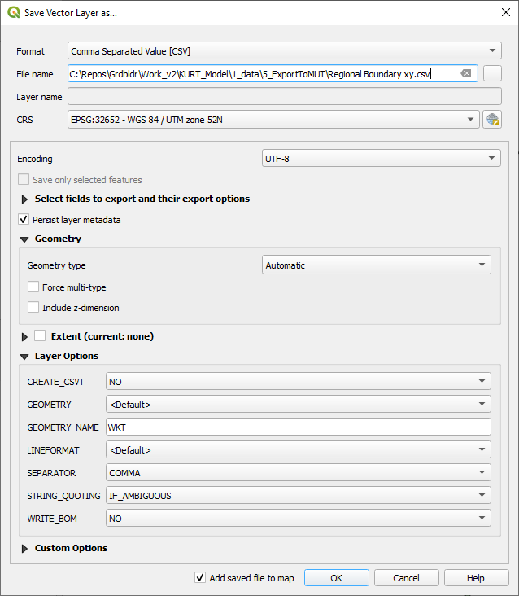
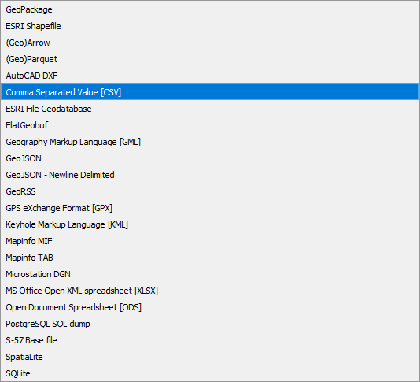
QGIS_ExportToCSVFile_2.png

Slide 15
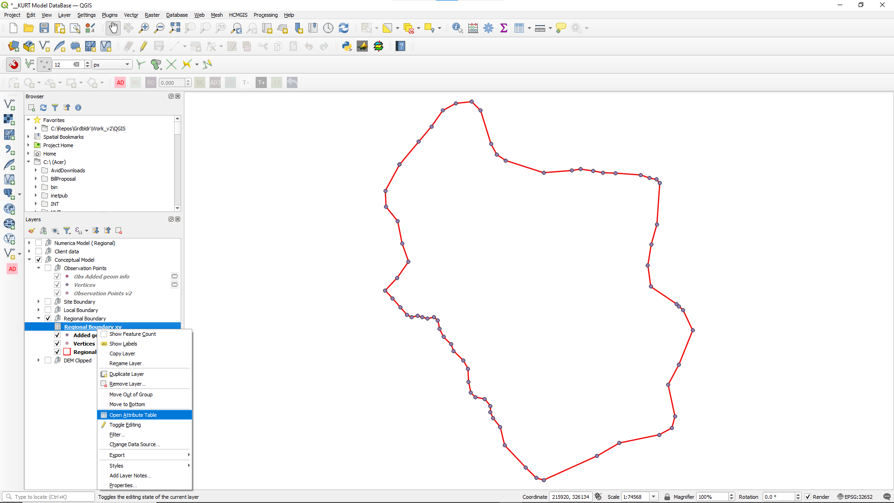
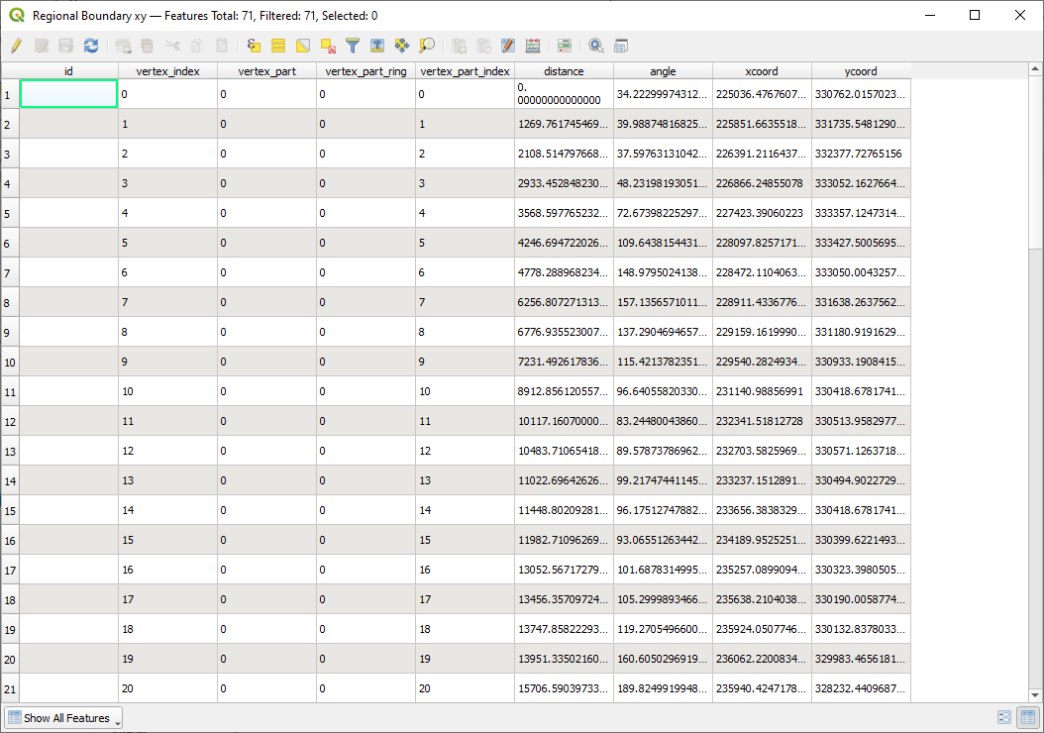
QGIS_ExportToCSVFile_3.png

Slide 16
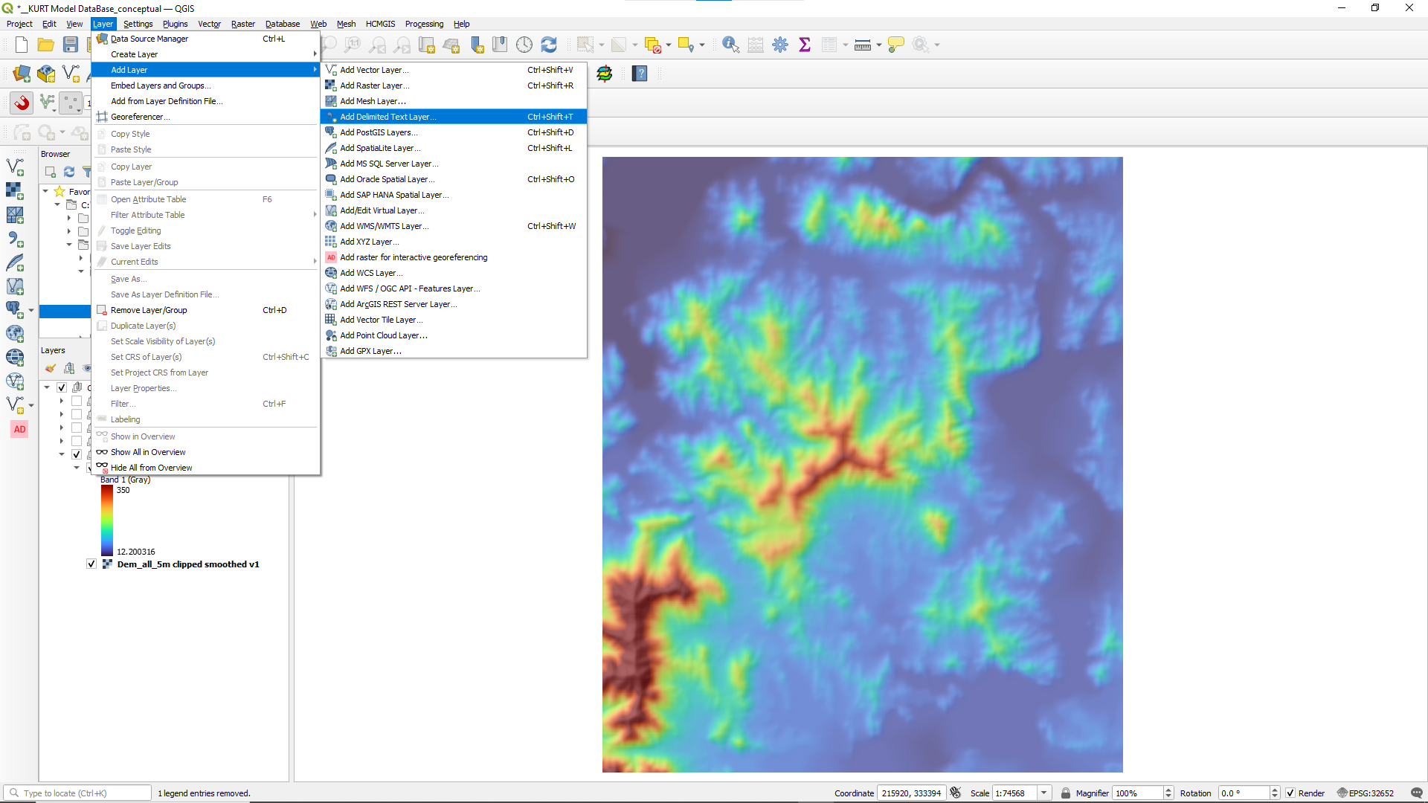
QGIS_ImportFromCSVFile_1.png

Slide 17
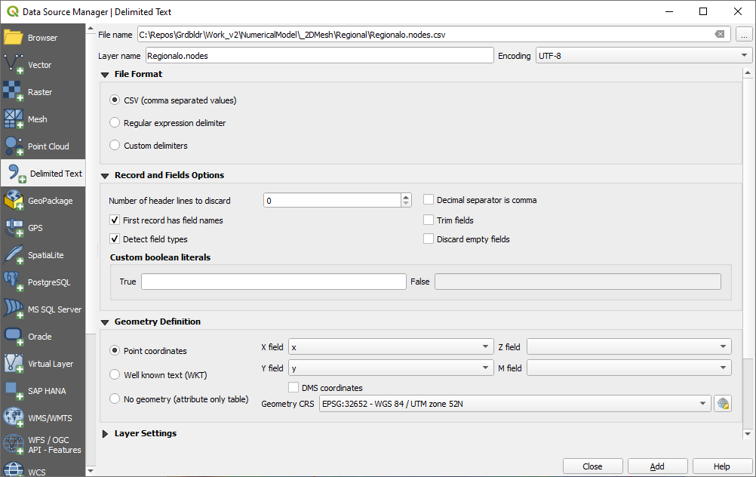
QGIS_ImportFromCSVFile_2.png

Slide 18
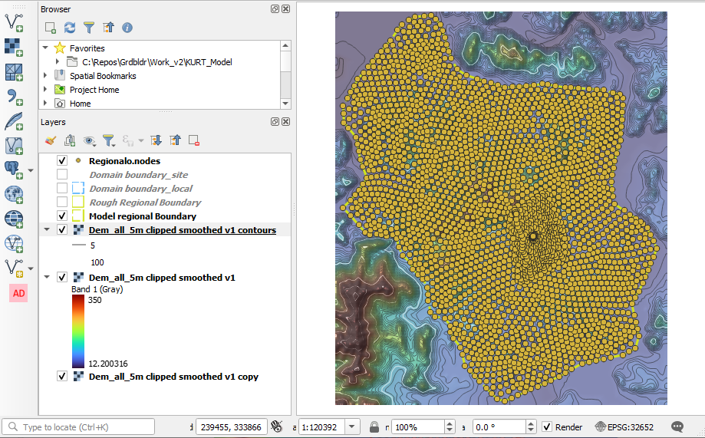
QGIS_ImportFromCSVFile_3.png

Slide 19
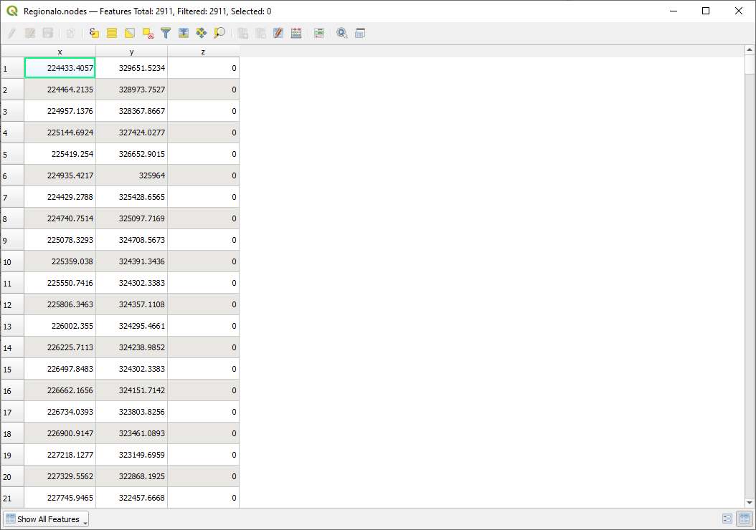
QGIS_ImportFromCSVFile_4.png

Slide 20
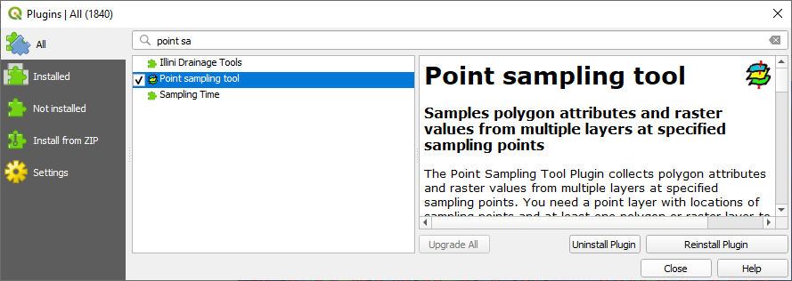
QGIS_PointSamplingToolPlugin_1.png

Slide 21

QGIS_PointSamplingToolIcon.png

Slide 22
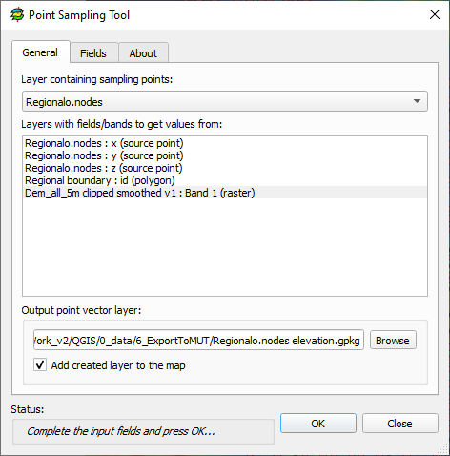
QGIS_PointSamplingToolPlugin_2.png

Slide 23
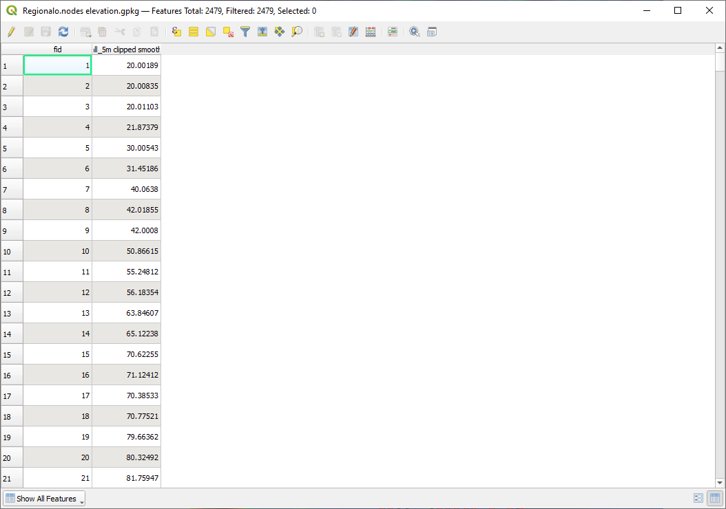
QGIS_PointSamplingToolPlugin_3.png

